Slide 1
Operation mistake(deleted “/prod” folder) on ojm01501
Date: 23rd Mar 2017

Slide 2
[1] Incident Description Summary
Time zone : JST
Incident No. | INC000001488763 (service request ticket No.)
Status | Resolved
Service/Category | MW team
Issue occur | 3/23/2017, 11:53
Detected time & date | 3/23/2017, 11:53
Resolved Time | 3/23/2017 18:16
Issue description | As user request to login ojm01501 to get Jboss configuration file. PIC copied target file to PIC’s home folder(/home/dz993148/ojm01501/prod), then use WinSCP to downloaded target file to local PC. Once got target file, PIC wanted to delete temp file, PIC used incorrect command to delete “/prod” folder, below is command detail. [root@ojm01501 ojm01501]# rm -rf arx111.cnf log4j_StdLog.xml mysql-ds.xml /prod
Impact | Production environment Because delete “/prod” folder, all Jboss instances could not work well. System name: 半事認証 情報BOX Arcstar
Cause | PIC used incorrect command to delete “/prod” folder
Action | 1) Education all DC members to review the high risk commands list and post on everybody's desk to pay high attention when use those commands. 2) Must use full path when exceute rm command. Must use parameter “-i” when directly execute rm command. Follow naming rule (ex. Add datetime characters) to create temp folder to avoid be same as production environment. Make procedure for executing high risk command, and must be double checked by another PIC before execution. Please refer “high risk commands list” in page.8.
Notes:
2

Slide 3
[2] Issue description
3/23/2017
As user request to login ojm01501 to get Jboss configuration file.
PIC copied target file to PIC’s home folder(/home/dz993148/ojm01501/prod),
then use WinSCP to downloaded target file to PC.
Once got target file, PIC wanted to delete temp file, but PIC used incorrect command to delete “/prod” folder.
PIC want to put parameter as “./prod”, but lost period, please refer below command information.
[root@ojm01501 server]# cd /home/dz993148/ojm01501
[root@ojm01501 ojm01501]#
[root@ojm01501 ojm01501]#
[root@ojm01501 ojm01501]# ls -l
total 16
-rwxr-x--- 1 arx1jbp arx1sysp 2045 Mar 7 2014 arx111.cnf
-rwxrwx--- 1 arx1cdp arx1sysp 180 Aug 10 2012 log4j_StdLog.xml
-rwxr----- 1 arx1jbp arx1sysp 2087 Aug 16 2012 mysql-ds.xml
drwxr-xr-x 2 root root 4096 Mar 23 11:52 prod
[root@ojm01501 ojm01501]# rm -rf arx111.cnf log4j_StdLog.xml mysql-ds.xml /prod
rm: cannot remove directory `/prod': Device or resource busy
[root@ojm01501 ojm01501]#
Incorrect:
[root@ojm01501 ojm01501]# rm -rf arx111.cnf log4j_StdLog.xml mysql-ds.xml /prod
Correct:
[root@ojm01501 ojm01501]# rm -rf arx111.cnf log4j_StdLog.xml mysql-ds.xml ./prod
Required to be used in future:
[root@ojm01501 ojm01501]# rm -r -i arx111.cnf log4j_StdLog.xml mysql-ds.xml /home/dz993148/ojm01501/prod
Issue
Notes:
3

Slide 4
[3] Root cause
Issue
Jboss instances could not work well
WHY 1
Deleted “/prod” on ojm01501
WHY 2
Enter incorrect path and use high risk parameter “ rm -rf”
Action 1
Education all DC members to review the high risk commands list and post on everybody's desk to pay high attention when use those commands.
Cause-1
PIC used high risk command without paying enough attention
Action 2
1.Must use full path(※) when execute rm command;
2.Must use parameter “-i” when directly execute rm command.
3. Follow naming rule (ex. Add datetime characters) to create temp folder to avoid be same as production environment.
4.Make procedure for executing high risk command, and must be double checked by another PIC before execution.
Cause-2
PIC didn’t use full path (absolute path )
※Full path : /home/xxxx/prod
Notes:
4

Slide 5
[4] Actions
Recommendations/Preventive Action:
No | Actions | Owner | Due date | Status
1 | Education all DC members to review the high risk commands list and post on everybody's desk to pay high attention when use those commands. | IBM | 3/31/2017 | Done
2 | 1.Must use full path when execute rm command; 2.Must use parameter “-i” when directly execute rm command. 3.Follow naming rule (ex. Add datetime characters) to create temp folder to avoid be same as production environment. 4.Make procedure for executing high risk command, and must be double checked by another PIC before execution. |  | 3/31/2017 | Done
Notes:
5

Slide 6
[5] Time line
2017/03/23 10:48 JST | User raised ticket(INC000001488763) require MW team to provide Jboss configuration file on ojm01501.
2017/03/23 11:07 JST | PIC replied user and plan to perform task.
2017/03/23 11:33 JST | PIC start to perform task and login ojm01501.
2017/03/23 11:37 JST | PIC created a temp fold in personal home folder(/home/dz993148/ojm01501)
2017/03/23 11:41 JST | PIC copied target file to temp folder and download it by WinSCP.
2017/03/23 11:51 JST | PIC tried to delete temp file and folder, but enter incorrect command to deleted “/prod” folder, and caused MW instances were not running well.
2017/03/23 11:53 JST | PIC was aware of this is a big operation mistake and escalated it TL and DM, and report issue to APP team.
2017/03/23 12:24 JST | Contacted with DC Linux & VMs team to discuss solution and discussed with APP team to decided recover plan.
2017/03/23 14:49 JST | APP and DC(MW/Linux/VMs team) joined the call and discussed recover plan.
2017/03/23 16:55 JST | Got APP approved and perform recover plan( recover VM snap shoot)
2017/03/23 17:50 JST | DC finished all task and sent mail to ask APP team to confirm application status.
2017/03/23 18:16 JST | APP confirmed that all applications are running well.
Notes:
6

Slide 7
[Appendix-1] Operation Log
[root@ojm01501 server]#
[root@ojm01501 server]# mkdir -p /home/dz993148/ojm01501/prod
[root@ojm01501 server]#
[root@ojm01501 server]#
[root@ojm01501 server]#
[root@ojm01501 server]# ls -l /home/dz993148/ojm01501
total 16
-rwxr-x--- 1 arx1jbp arx1sysp 2045 Mar 7 2014 arx111.cnf
-rwxrwx--- 1 arx1cdp arx1sysp 180 Aug 10 2012 log4j_StdLog.xml
-rwxr----- 1 arx1jbp arx1sysp 2087 Aug 16 2012 mysql-ds.xml
drwxr-xr-x 2 root root 4096 Mar 23 11:52 prod
[root@ojm01501 server]#
[root@ojm01501 server]#
[root@ojm01501 server]#
[root@ojm01501 server]# rm -rf arx111.cnf log4j_StdLog.xmlrf /home/dz993148/ojm01501 /arx111.cnf,pwd
/pp/jbosshome_arx1/jboss-5.1/server
[root@ojm01501 server]#
[root@ojm01501 server]#
[root@ojm01501 server]# cd /home/dz993148/ojm01501
[root@ojm01501 ojm01501]#
[root@ojm01501 ojm01501]#
[root@ojm01501 ojm01501]# ls -l
total 16
-rwxr-x--- 1 arx1jbp arx1sysp 2045 Mar 7 2014 arx111.cnf
-rwxrwx--- 1 arx1cdp arx1sysp 180 Aug 10 2012 log4j_StdLog.xml
-rwxr----- 1 arx1jbp arx1sysp 2087 Aug 16 2012 mysql-ds.xml
drwxr-xr-x 2 root root 4096 Mar 23 11:52 prod
[root@ojm01501 ojm01501]# rm -rf arx111.cnf log4j_StdLog.xml mysql-ds.xml /prod
rm: cannot remove directory `/prod': Device or resource busy
[root@ojm01501 ojm01501]#
[root@ojm01501 ojm01501]#
Notes:
7

Slide 8
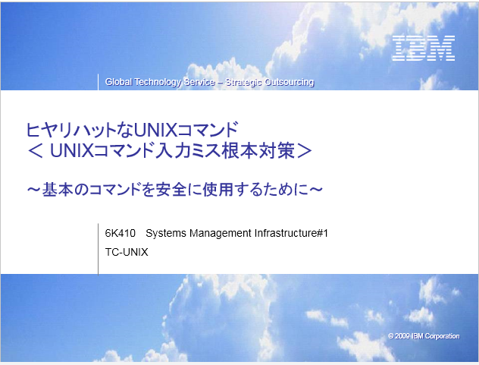
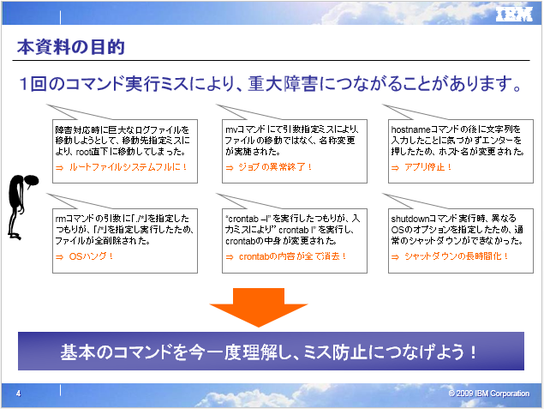
[Appendix-2] High risk command list
high-risk command list.ppt
Below high risk command are included:
mvコマンド
rmコマンド
hostnameコマンド
crontabコマンド
shutdownコマンド
Notes:
8

Slide 9

Thank You

